Slide 1
ECCDH3DES
Team 3 Members: Nico Bellante, Lucas Dahl, Manish Gupta, Xiong-Yao Zha
Lab Section 3
TA: Yunus Akhtar
4/28/15
1

Slide 2

What have we designed?
We designed a chip used for secure transmission of data.
Our
Chip
Our
Chip
2

Slide 3
Why would someone want to use your chip?
Using 163 bits as our key size for ECC, we are able to achieve a greater security than RSA with 1024 bit keys.
Our encryption is implemented using a 48 stage pipelined Triple DES algorithm that allows for 64 bits of data to be encrypted on each clock cycle.
3

Slide 4
Why is this design appropriate for hardware?
We chose to implement ECC using Galois Fields, a domain perfect for hardware.
Fixed size bit patterns
Addition in GF is xors
DES was originally designed for hardware.
4

Slide 5
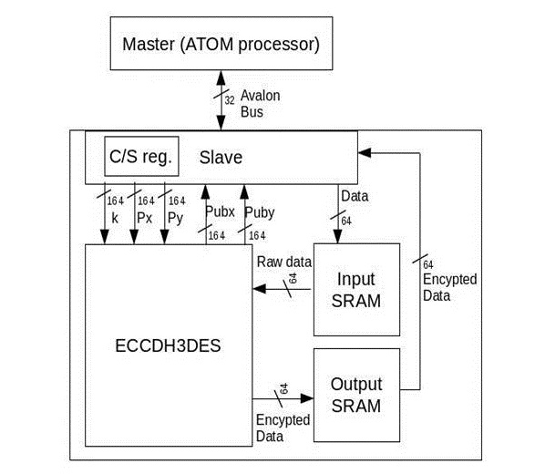
System Design on FPGA
5

Slide 6
Sequence of Operations
Upon reset generate and broadcast our Public key using ECC of our Private key
Then we generate a session key using ECC of our Private key and another party's Public key
Finally we encrypt data using Triple DES encryption with our created session key
6

Slide 7
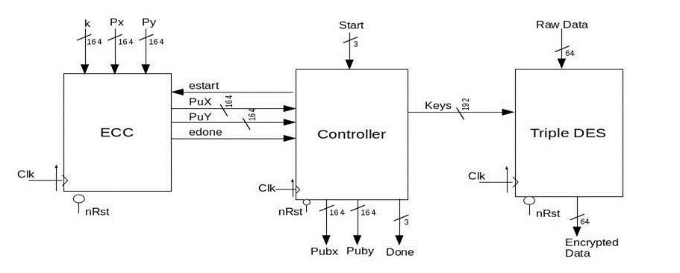
Internal Architecture
7

Slide 8
Design Decisions
We chose to optimize the area of our ECC module.
Our ECC algorithm is only run once before encrypting data.
We chose to pipeline our DES so we could have encrypted data coming out every clock cycle.
8

Slide 9
Improvements we've made
We reduced the total area from 300 cm^2 down to 3 cm^2 and then further to our final of 36mm^2
We managed to reduce our critical path of ECC down from 8ns down to just under 4ns.
We changed the design of the controller to allow for more user control.
9

Slide 10
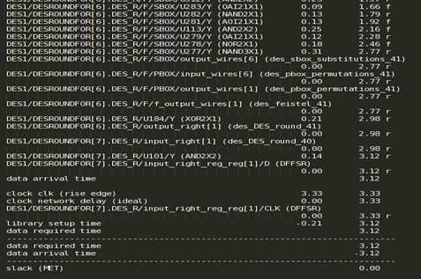
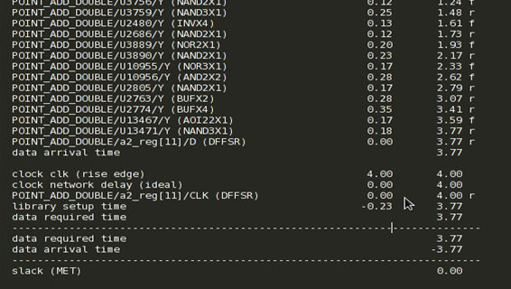
Critical Paths
DES ECC
10

Slide 11
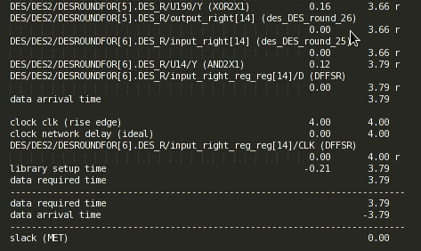
Critical Paths
OVERALL
11

Slide 12
Area
Total Area in mm^2 = 36.58
12

Slide 13
Power
Total power in mW = 9888.442
13

Slide 14
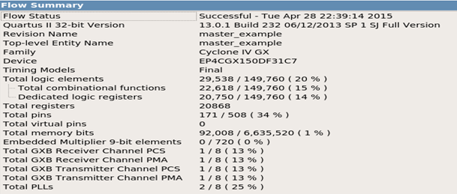

Quartus report
Area on the FPGA
FPGA Clock
14

Slide 15
Design Specific Success Criteria (DSSC)
Demonstrate by simulation of a Verilog test bench:
That the public keys of A that are generated are correct.
That the values of Skx and Sky are both generated correctly.
That the controller module correctly transitions through its states.
That given a key, the Triple DES encryption gives the correct output values.
15

Slide 16
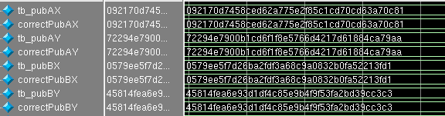
ECC Test Results
The generated Public Keys of A and B match that of the python implementation.
Satisfies DSSC #1
16

Slide 17
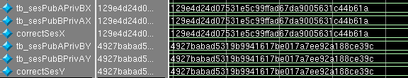
ECC Test Results
The generated Session keys of A and B match each other as well as the python implementation.
Satisfies DSSC #2
17

Slide 18
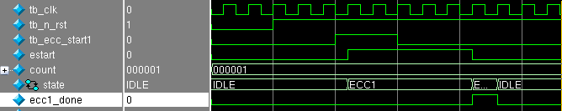
Controller Test Results
Coming off reset the controller goes through the states of the initial ECC key generation.
A done signal is asserted when ECC has finished.
Satisfies DSSC #3
18

Slide 19
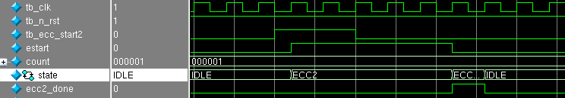
Controller Test Results
Given a start signal the Controller goes through the states for the ECC session key generation.
A done signal is asserted when ECC has finished.
Satisfies DSSC #3
19

Slide 20
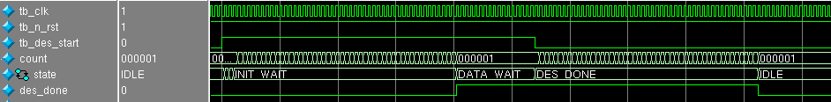


Controller Test Results
The Controller goes through two initial wait states.
Then it waits for the start signal to be deasserted.
Lastly it deasserts the done signal and goes to the IDLE state after 48 cycle delay.
Satisfies DSSC #3
20

Slide 21
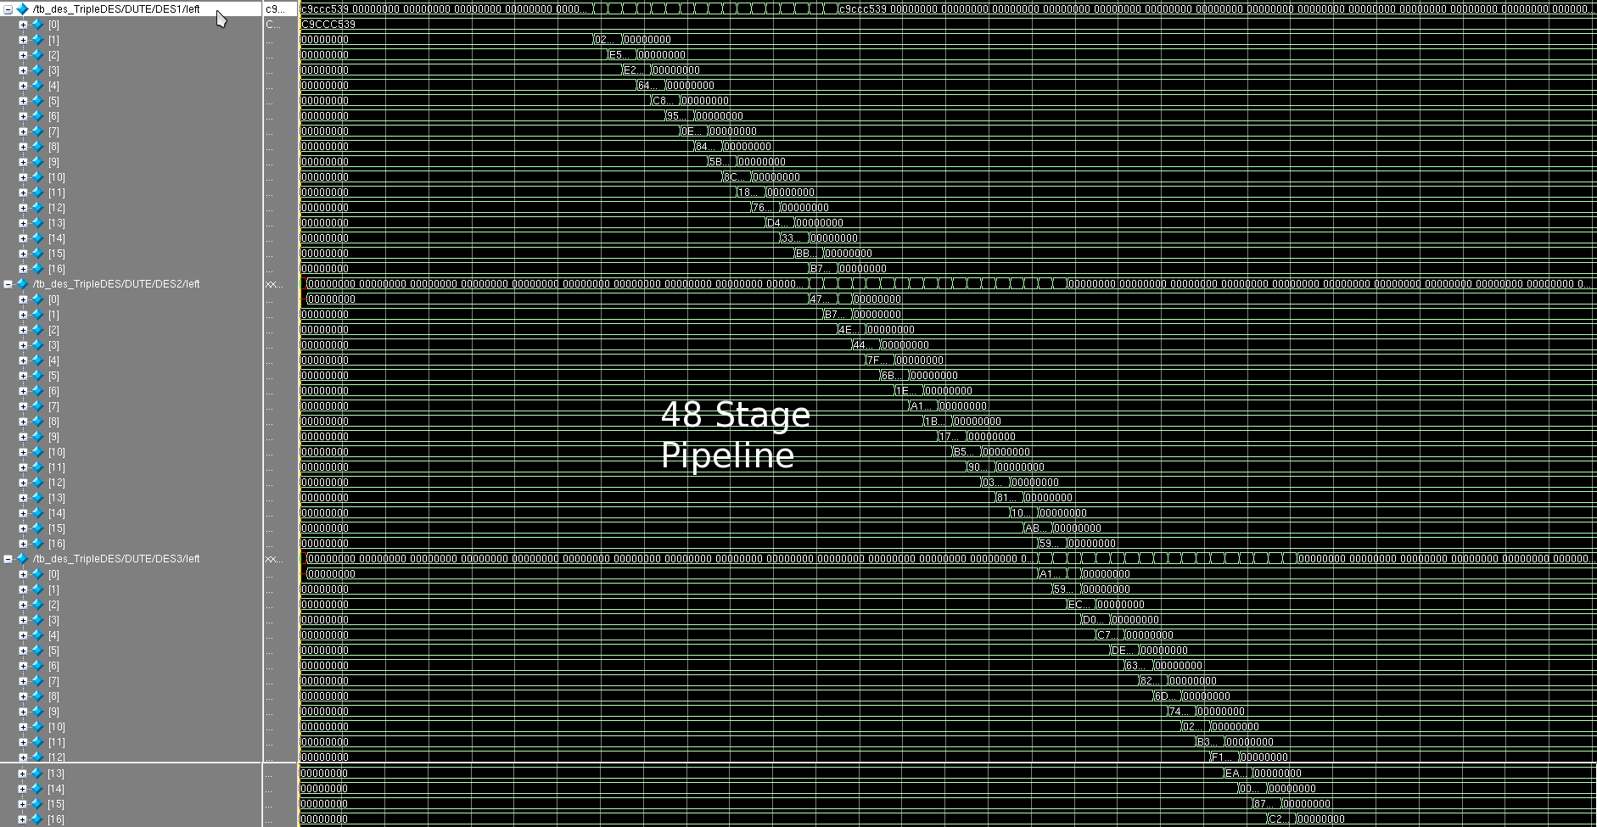
Triple DES Test Results
21

Slide 22
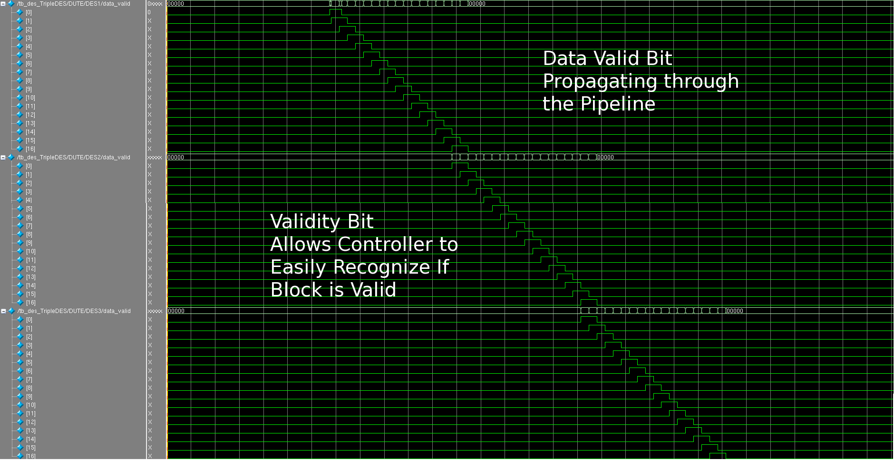
Triple DES Test Results
22

Slide 23
Triple DES Test Results
The output of our module matches that of the online Triple DES encryption using the same key.
Satisfies DSSC #4
23

Slide 24
Conclusions
Challenges we faced:
Implementing the ECC algorithms
Debugging and optimizing ECC
FPGA implementation
If we were to do this project again we would research alternate algorithms for ECC.
If we had more time we would have improved our design by using a more versatile bus protocol.
24

Slide 25
Questions?

Slide 26
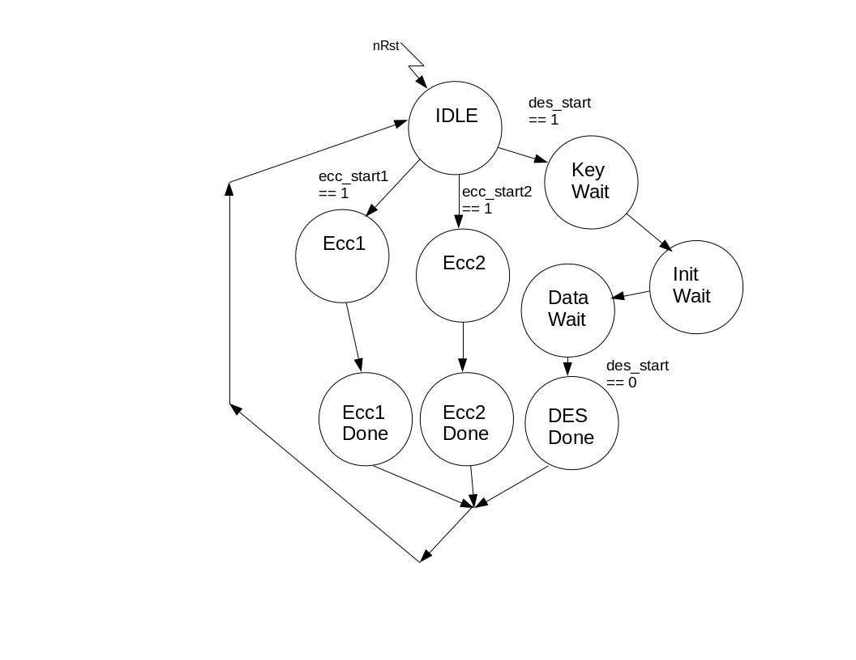
Diagrams for Reference
Controller:

Slide 27
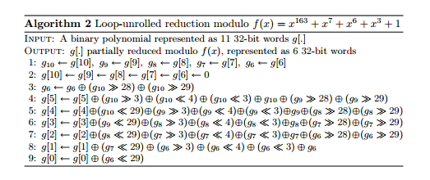
Diagrams for Reference
GF_mod:

Slide 28
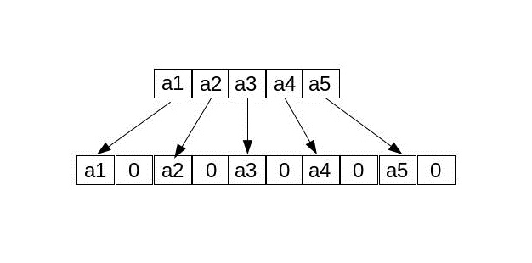
Diagrams for Reference
GF_square

Slide 29
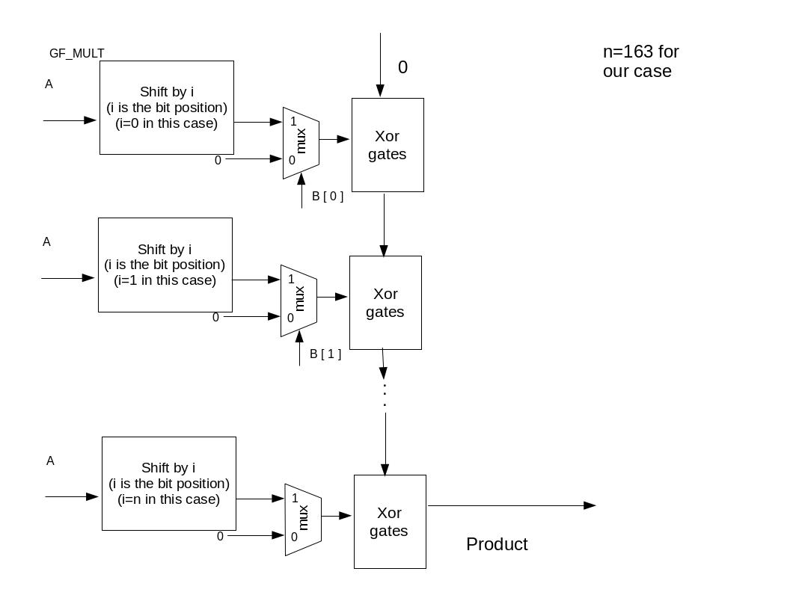
Diagrams for Reference
GF_mult

Slide 30
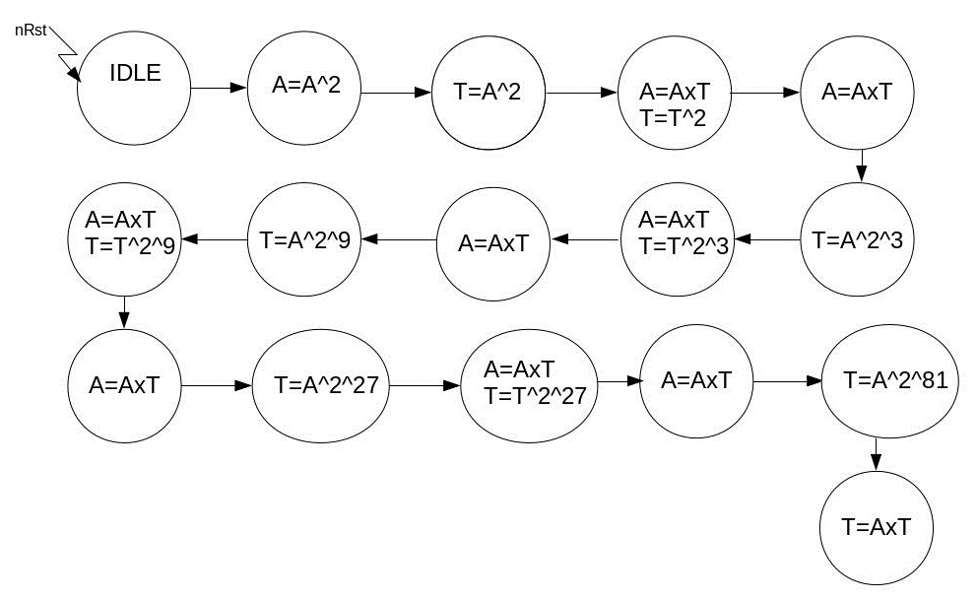
Diagrams for Reference
GF_divide

Slide 31
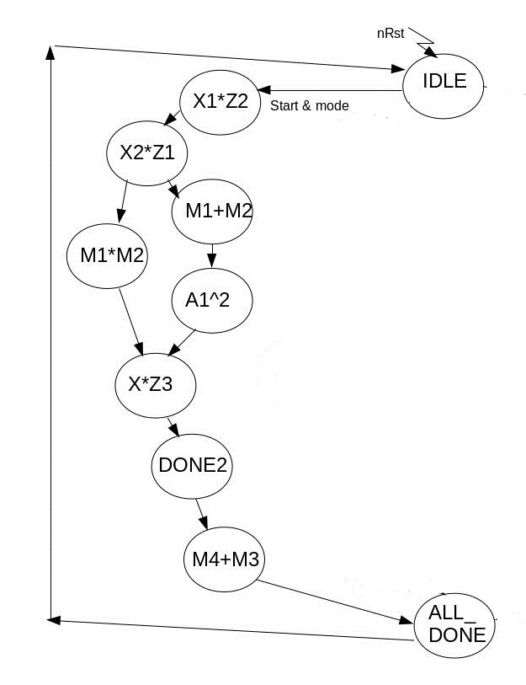
Diagrams for Reference
Point Addition

Slide 32
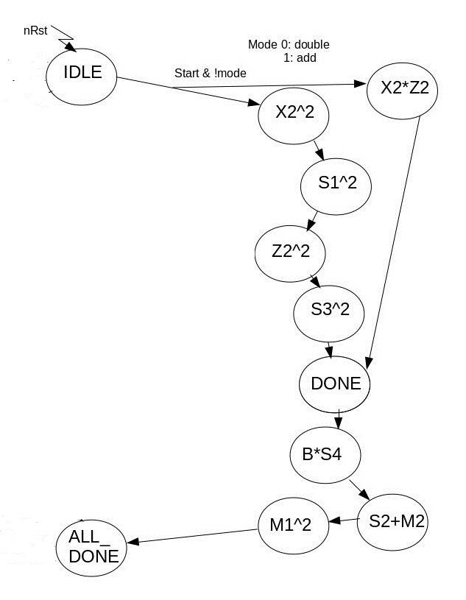
Diagrams for Reference
Point Double

Slide 33
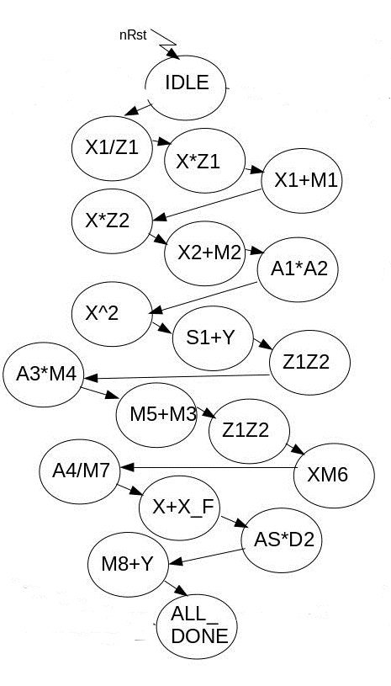
Diagrams for Reference
Mxy

Slide 34
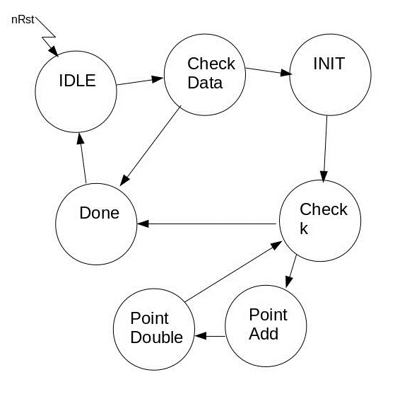
Diagrams for Reference
Point Multiplication

Slide 35
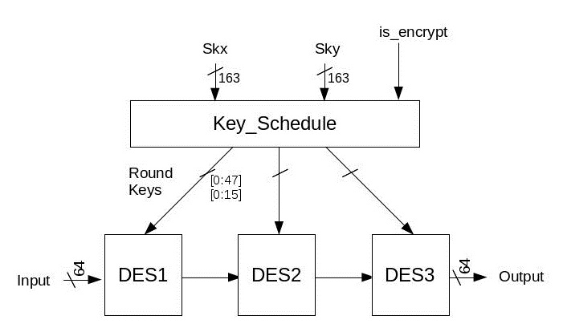
Diagrams for Reference
Triple DES

Slide 36
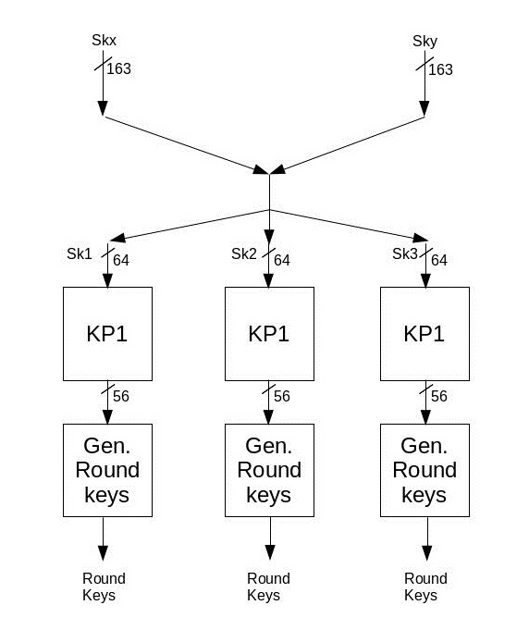
Diagrams for Reference
Key Schedule

Slide 37
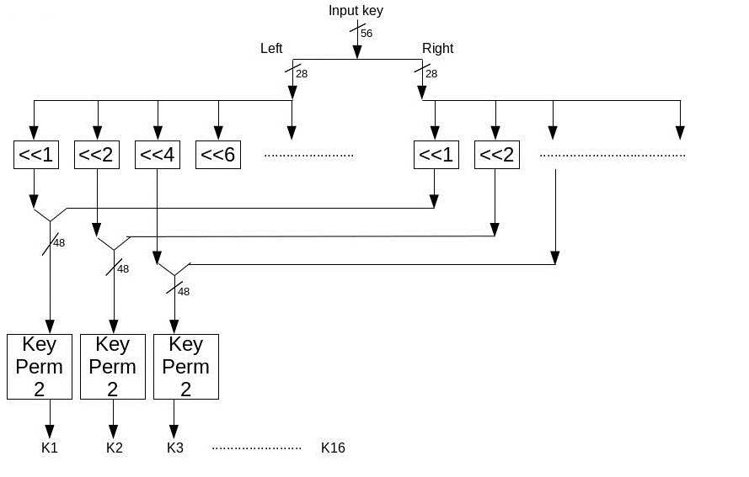
Diagrams for Reference
Generate Round Keys

Slide 38
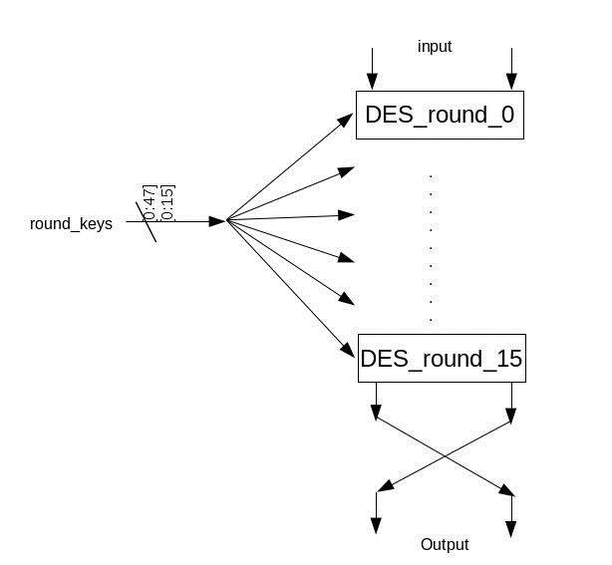
Diagrams for Reference
DES

Slide 39
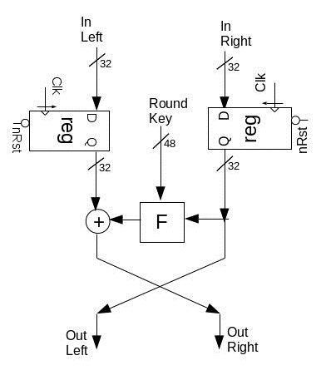
Diagrams for Reference
DES_Round

Slide 40
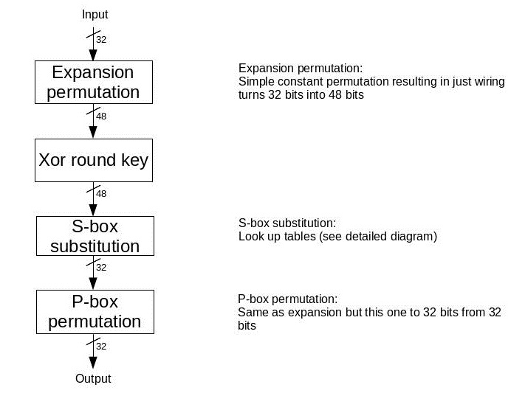
Diagrams for Reference
Feistel

Slide 41
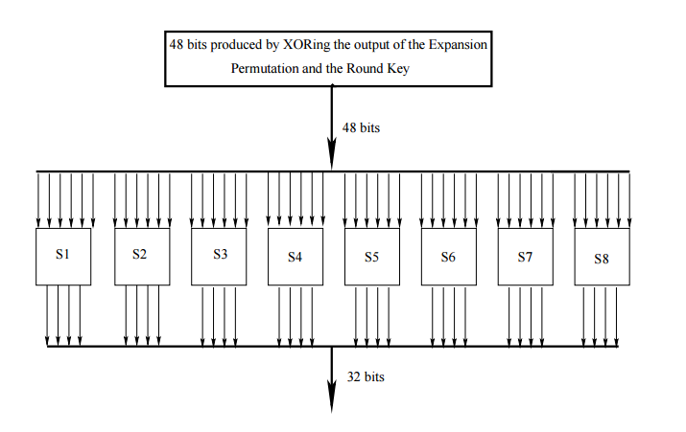
Diagrams for Reference
S-Box Substitutions

Slide 42
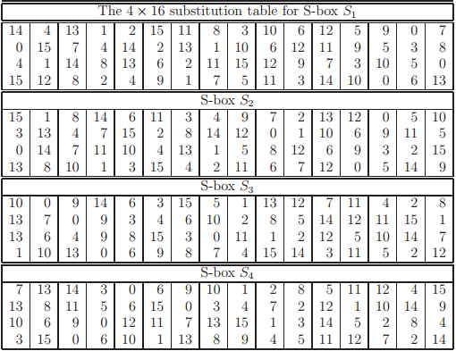
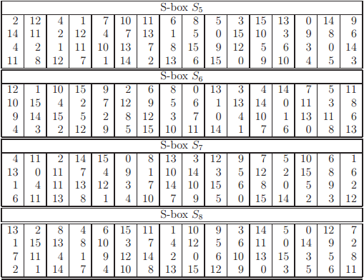
Diagrams for Reference
S-Box Substitution

